Slide 1
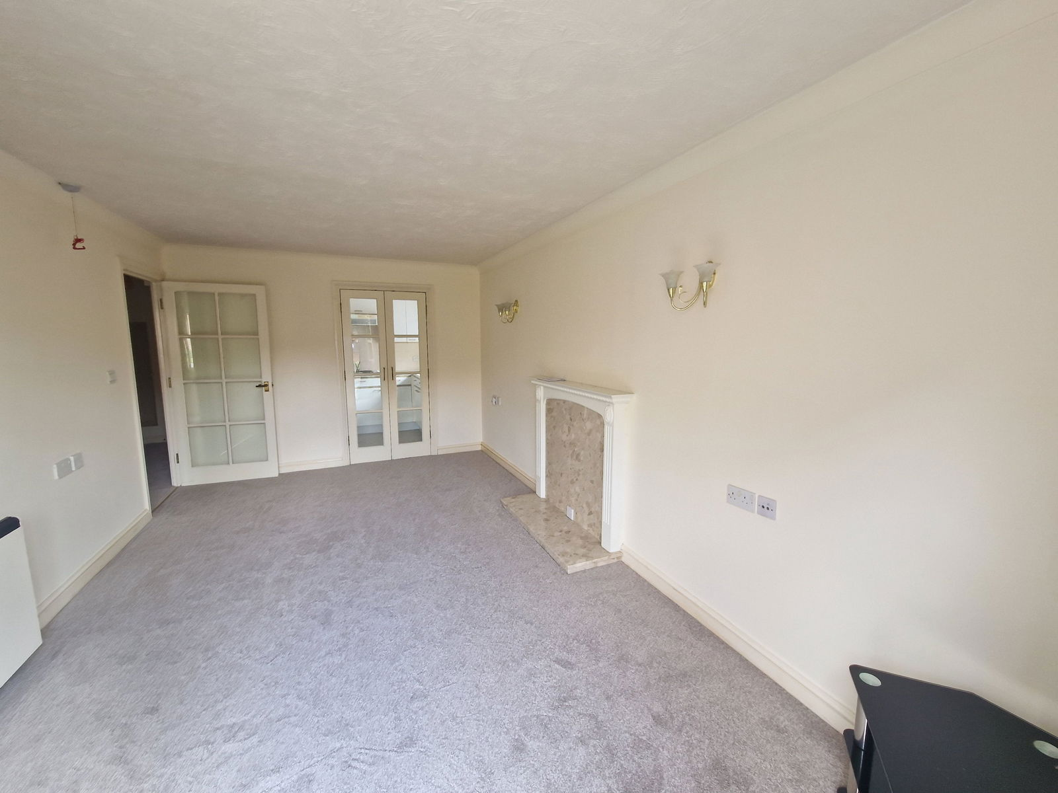
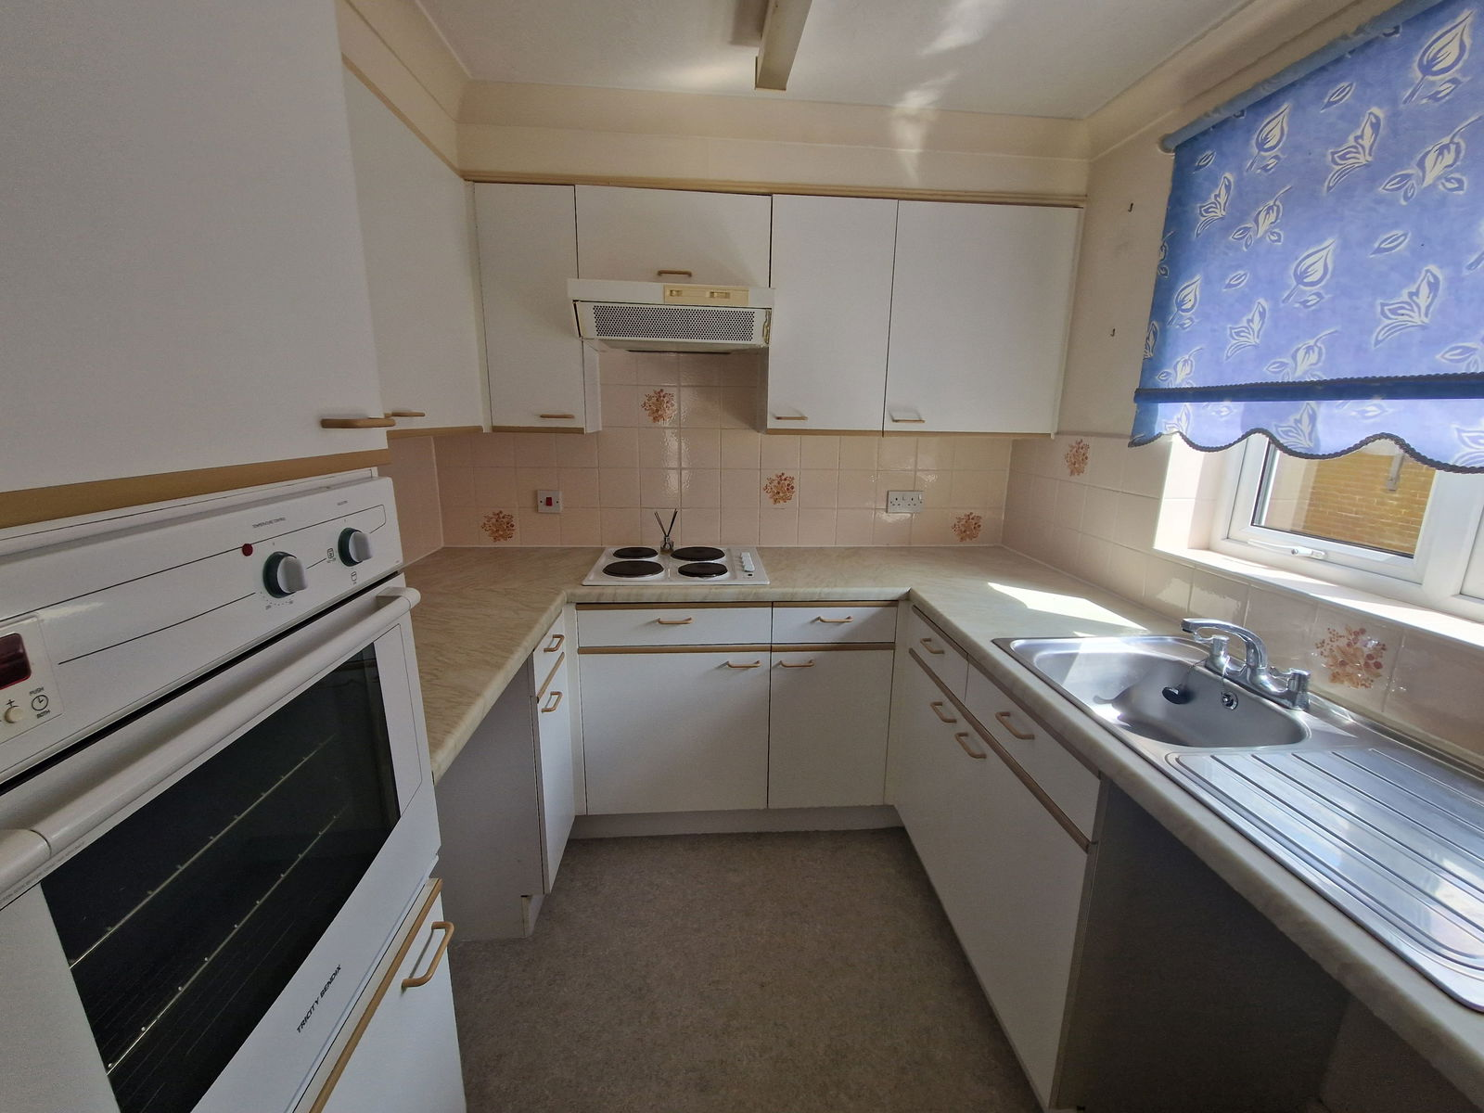

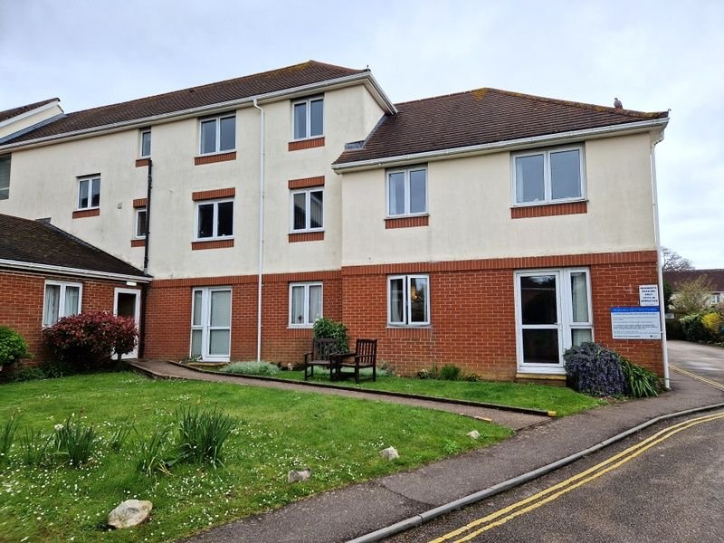
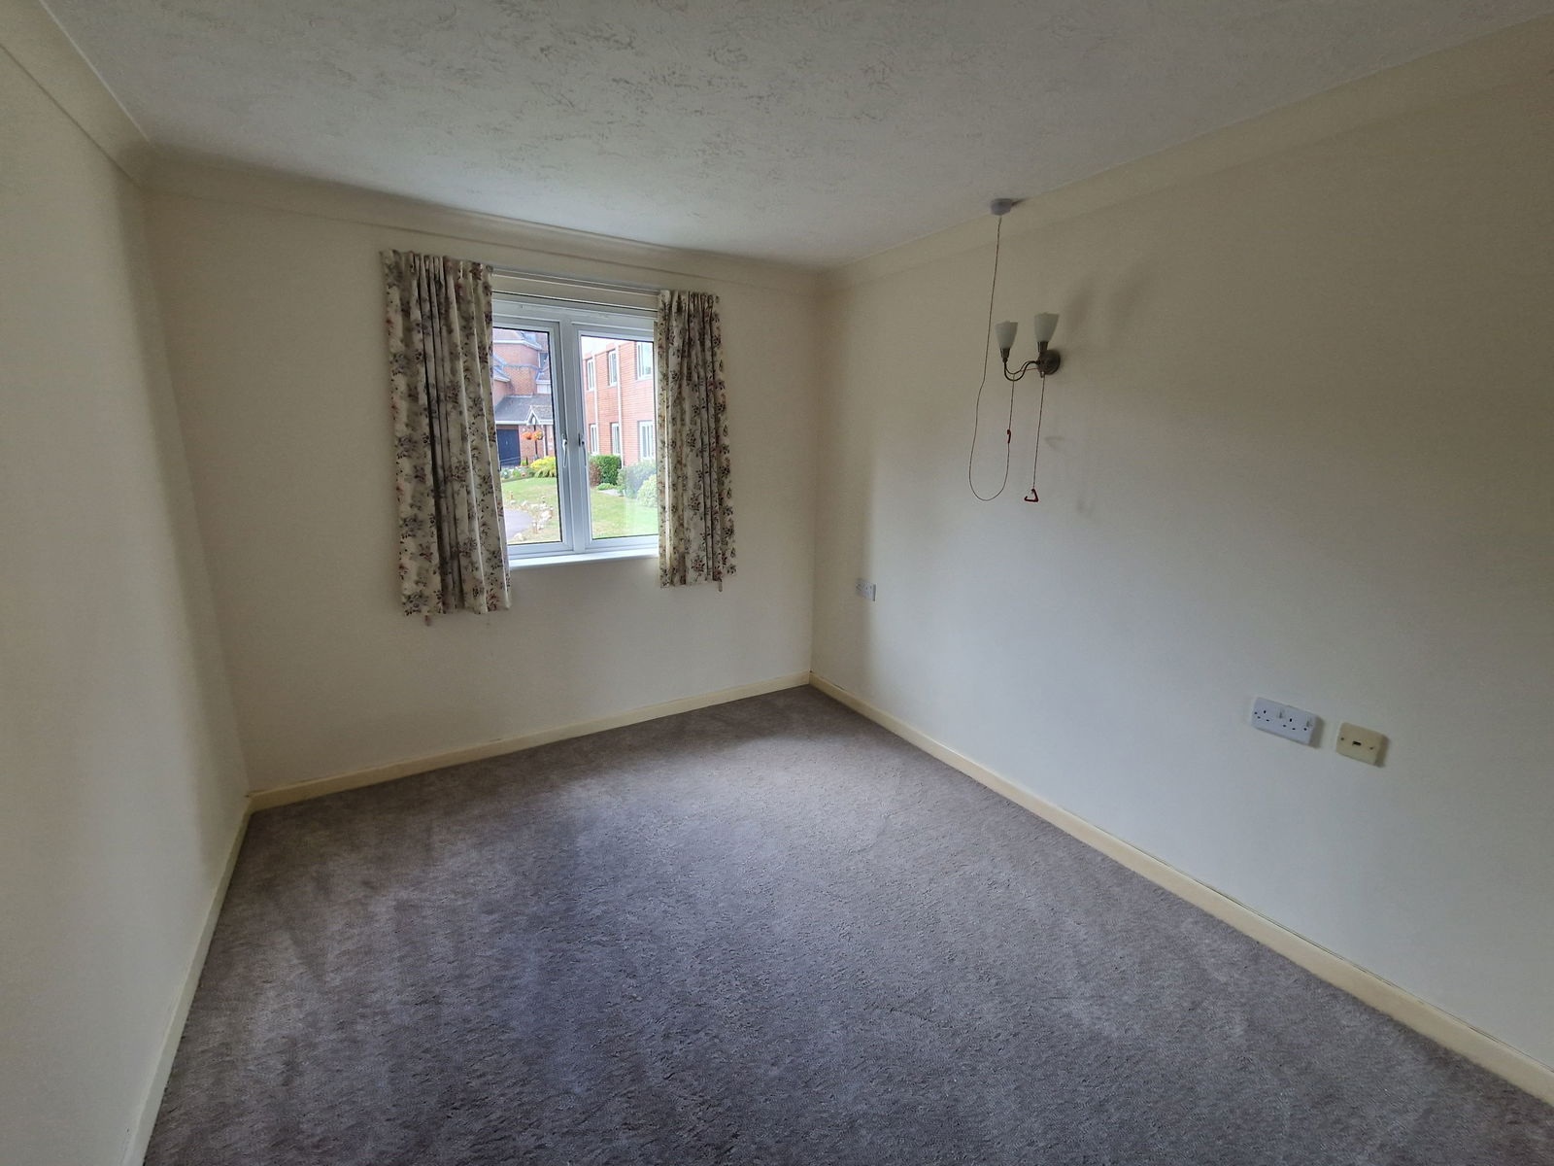
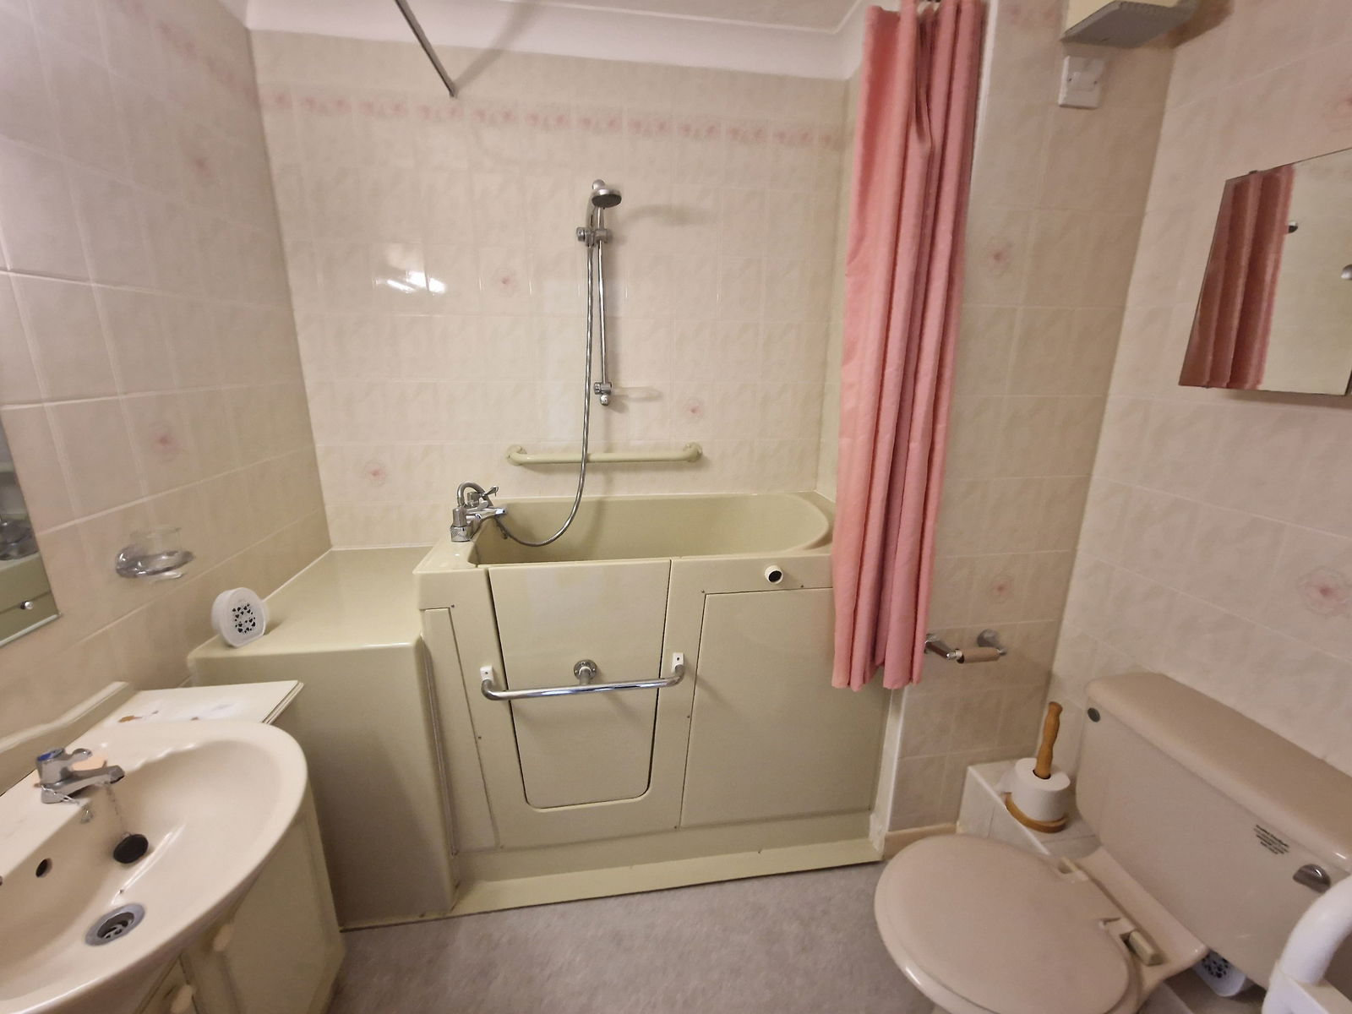
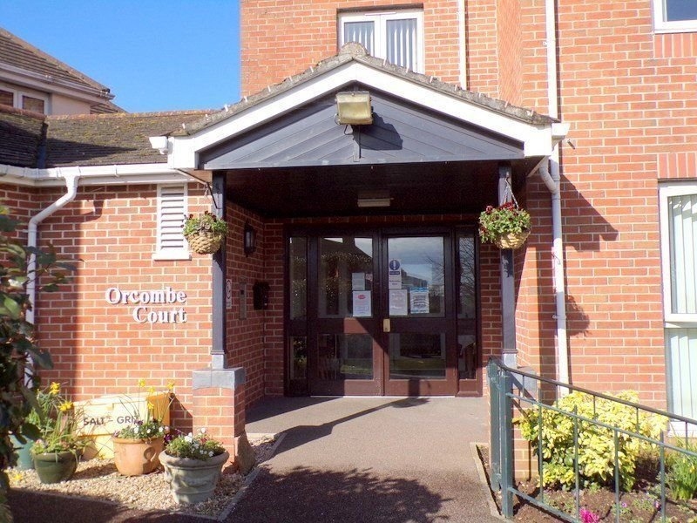
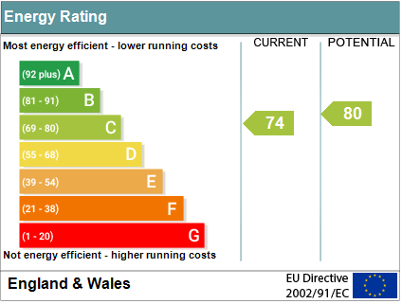

www.pennys.net
Flat 17 Orcombe Court, Littleham Road, Exmouth, EX8 2ET
GUIDE PRICE £90,000
TENURE Leasehold
A Well Presented Ground Floor Flat Located In A Popular Development Close To Amenities
Lounge/Dining Room • Kitchen • Double Bedroom •
Bathroom/WC With Ease Of Access Bath • Double Glazed Windows •
Excellent Communal Facilities • House Manager • No Onward Chain •
New Floor Coverings Throughout •
Pennys Estate Agents Limited for themselves and for the vendor of this property whose agents they are give notice that:- (1) These particulars do not constitute any part of an offer or a contract. (2) All statements contained in these particulars are made without responsibility on the part of Pennys Estate Agents Limited. (3) None of the statements contained in these particulars are to be relied upon as a statement or representation of fact. (4) Any intending purchaser must satisfy himself/herself by inspection or otherwise as to the correctness of each of the statements contained in these particulars. (5) The vendor does not make or give and neither do Pennys Estate Agents Limited nor any person in their employment has any authority to make or give any representation or warranty whatever in relation to this property.
PENNYS ESTATE AGENTS
2 Rolle House, Rolle Street, Exmouth, Devon, EX8 2SN
Tel: 01395 264111 EMail: help@pennys.net

Slide 2
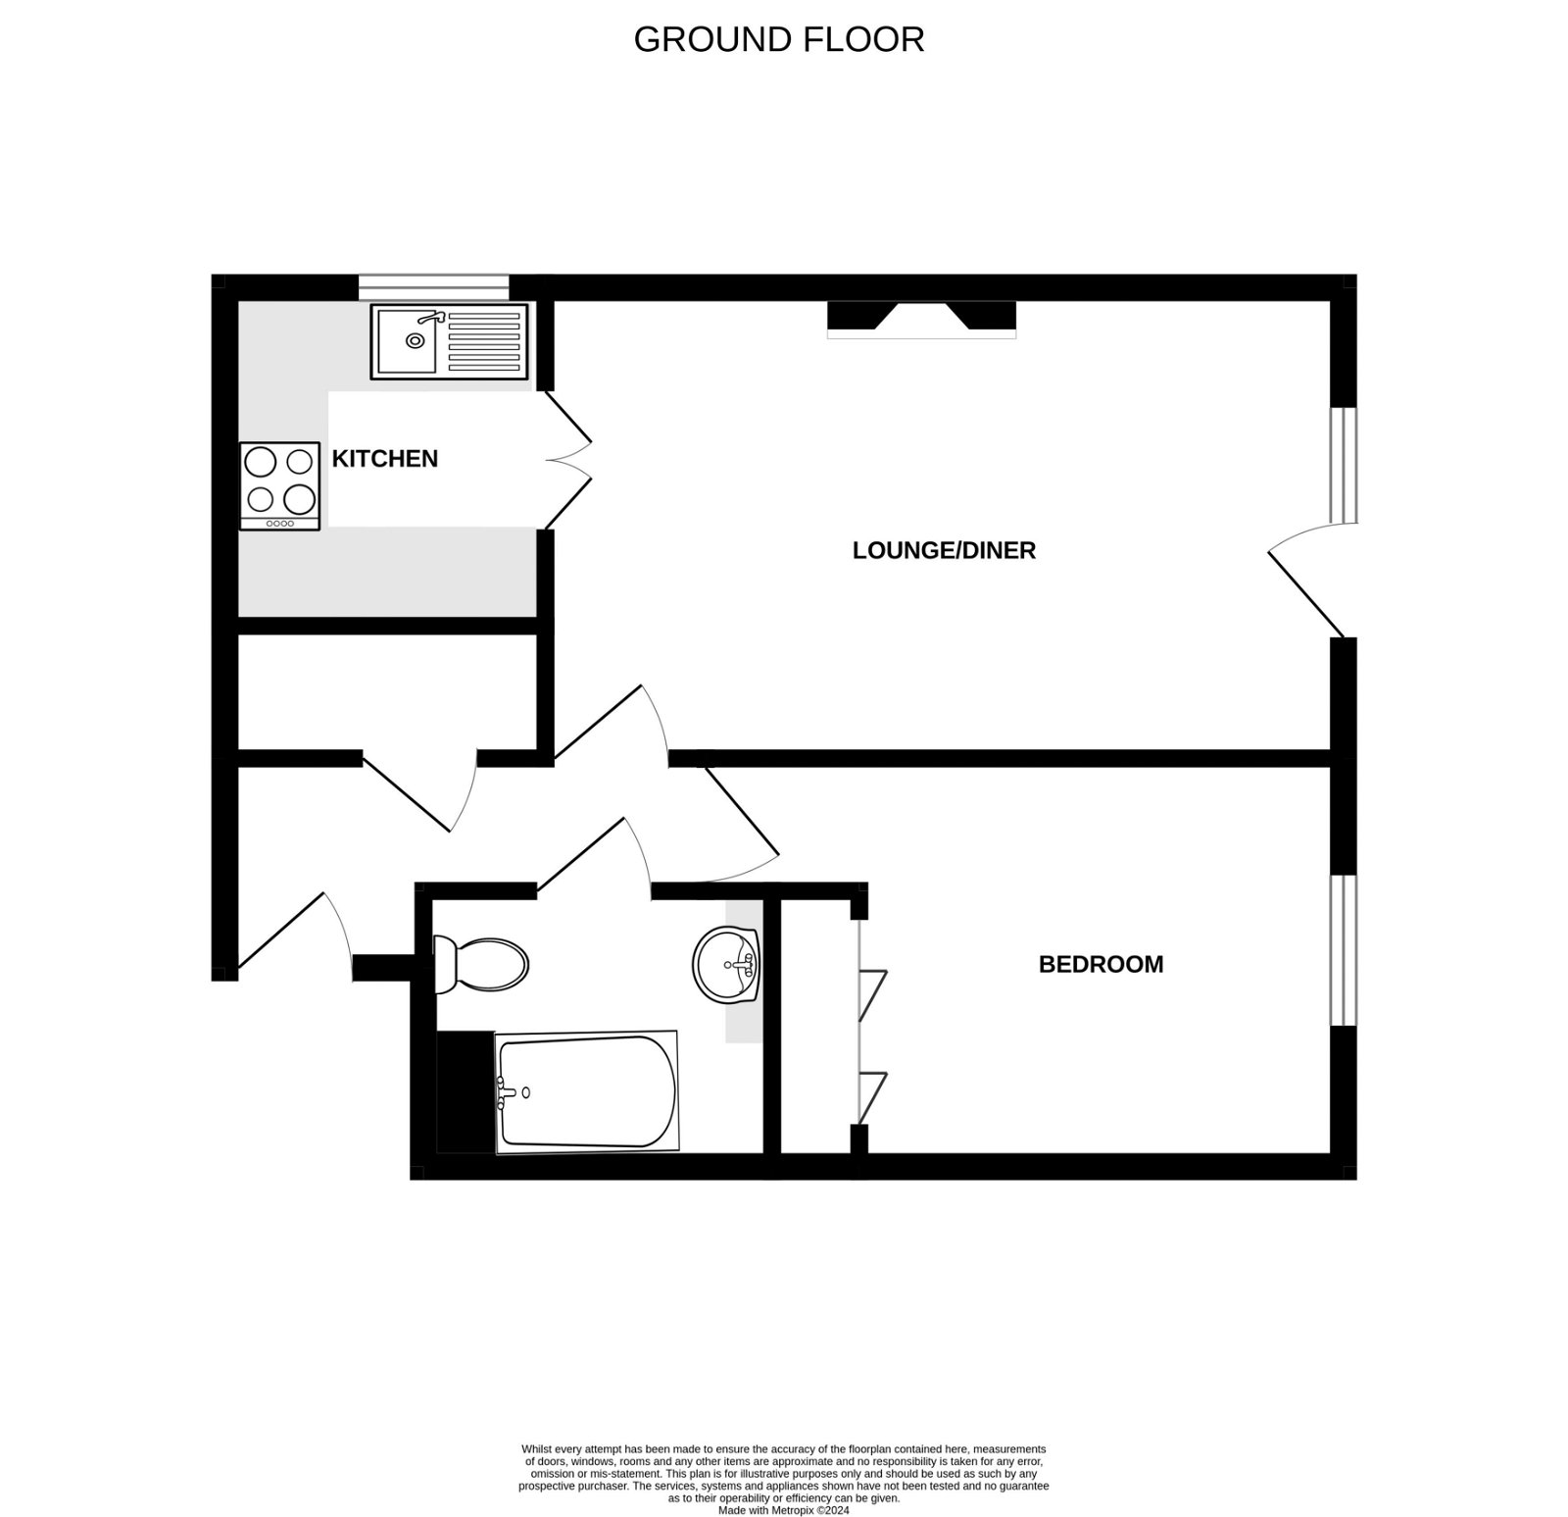
Flat 17 Orcombe Court, Littleham Road, Exmouth, EX8 2ET
Orcombe Court was constructed by McCarthy & Stone (Developments) Limited and comprises of 57 apartments in 3 separate blocks connected by a single storey walk-way, each served by a lift. The development manager can be contacted from various points within the development and also has an office. For period when the manager is off duty there is a 24 hour emergency Appello call system. It is a condition of the purchase the residents be over the age of 55 years. This apartment is located on the GROUND FLOOR.
THE ACCOMMODATION COMPRISES: Own private front door to:
RECEPTION HALL: Door entry intercom and emergency care cord; good size airing cupboard with water cylinder, slatted shelving, light and electric consumer unit.
LOUNGE/DINING ROOM: 5.18m x 3.12m (17'0" x 10'3") Double glazed window and patio doors to OUTSIDE; night storage heater; fire surround; television point; telephone point; wall lighting; emergency care line cord; glass panelled doors to:
KITCHEN: 2.24m x 2.13m (7'4" x 7'0") Worktop surfaces with tiled surrounds; cupboards, drawer units and appliance space beneath; inset single drainer sink unit; four ring electric hob with extractor hood over; built-in oven; wall mounted cupboards; double glazed window; electric wall heater.
BEDROOM: 4.27m x 2.72m (14'0" x 8'11") Including door recess. Double glazed window; built-in wardrobes with mirror fronted doors; wall lighting; emergency care line cord.
BATHROOM/WC: 2.13m x 1.7m (7'0" x 5'7") With ease of access bath with shower over, shower cubicle and shower rail; vanity wash hand basin; WC; fitted mirror with light over; fully tiled walls; electric heated towel rail; extractor fan; mirror fronted medicine cabinet.
OUTSIDE: The property is approached by a brick columned entrance giving access to a sweeping tarmaced drive which leads to visitors parking to the rear of the building. Parking for residents is available subject to availability. There are various areas of communal gardens comprising lawns and well tended flowerbeds and borders.
TENURE AND OUTGOINGS: Leasehold. Service Charge: £1,569.20 half yearly. Ground Rent: £260 half yearly.
FLOOR PLAN:

